Slide 1
The Complete Education Central Website
Project Partners:
Maor Ben Yair
Yarin Shitrit
Daniel Ohayon
Daniel Yona
Netanel Reuven

Slide 2
Association Description
The purpose of the association is to make every youth in Israel accessible to a variety of educational solutions, to reduce social disparities and provide equal opportunities for everyone, while creating a coalition of educators, building a community, and making partnerships with government ministries, authorities, business and third sector. The association will provide educational and moral values tools, that will enable the youth to excel, integrate into society as a contributing citizen and a leader, characterize and implement a technological platform integrated with artificial intelligence that will enable fast, smart and effective connection between non-formal education, government ministries, authorities, schools, communities and the youth, developing relevant educational solutions and connecting them to educational institutions abroad in order to promote Israel as an educational nation.

Slide 3
Organizational Process Today
For each new activity created, the association sends a registration form to all students stored on the database (Excel spreadsheet) by email, a text message with the meeting details is then sent to all registered trainees via a WhatsApp group, a process that sets difficulties for the association in terms of manpower and complication of creating and managing an activity.

Slide 4
Project Target
The goal of the project is to simplify the process by creating a convenient platform that will allow the association's trainees to take part in various activities and track their progress, using a custom and convenient system. In addition, the platform will allow content providers to monitor the progress of the trainees for each of their activities.

Slide 5
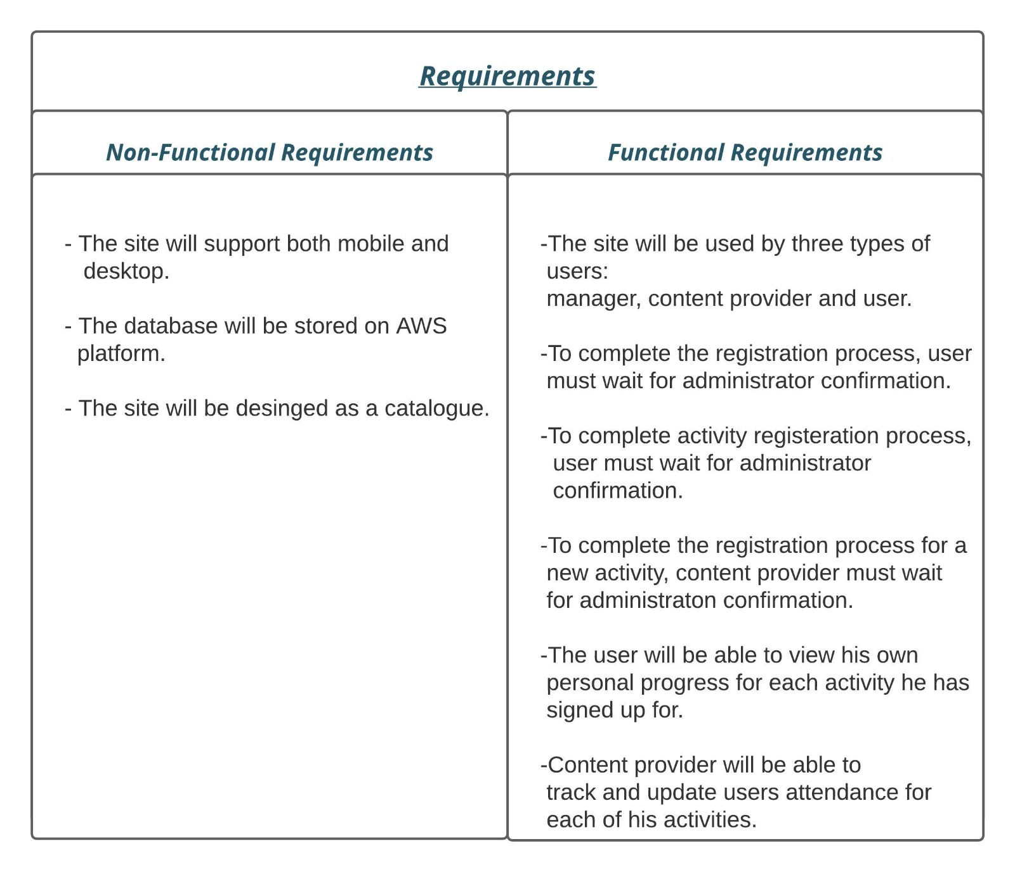

Slide 6
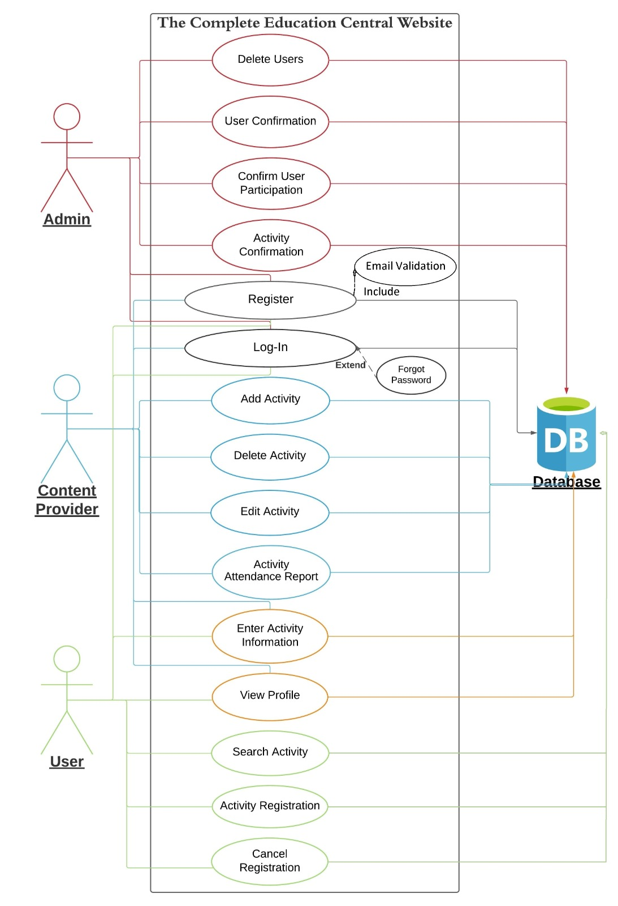
Use Case Diagram

Slide 7
Use Cases Templates

Slide 8
User Confirmation
Actors → Administrator
Pre-Condition:
Signed in as an administrator and there is at-least one pending User Applications.
Basic Flow:
The administrator will enter the pending applications area.
Viewing the list, the administrator will pick one application to review.
After reviewing the application manually, the administrator approves the application by pressing the button at the bottom of the page.
After approved, the user's status in the data-base will change from "pending" to "approved".
Alternate Flow:
After reviewing the application, the administrator denies the application by pressing the button at the bottom of the page, after pressing the button the administrator will provide the reason for the denial.
After denied, the user's status in the data-base will change from "pending" to "denied".
Exceptions Flow:
There are no applications to review.
Post Condition:
The user's status in the data-base has been updated accordingly, if approved he'll be able to register to courses. If denied, will receive an e-mail with the denial reason.

Slide 9
Activity Registration
Actors → User
Pre-Condition:
Signed in as a user, there are courses in the catalogue.
Basic Flow:
The user will pick an activity from the activity’s catalogue and press the register button.
The user will be requested to confirm his desire to register to the activity.
After confirming, the user will get a message that he's been added to the pending list for the activity.
Alternate Flow:
The user cancels his action of the registration and stops the process.
Exceptions Flow: --
Post Condition:
If registered, the user will receive a message notifying him that his registration is pending.

Slide 10
Activity Confirmation
Actors → Administrator
Pre-Condition:
Signed in as an administrator and there is at-least one pending activity applications
Basic Flow:
The administrator will enter the pending applications area.
Viewing the list, the administrator will pick one application to review.
After reviewing the application manually, the administrator approves the application by pressing the button at the bottom of the page.
After approved, the activity’s status in the data-base will change from "pending" to "approved".
After the data-base update, the activity now is visible to all approved users and they may register to the course.
The contact supplier will be notified that his activity has been approved.
Alternate Flow:
3. After reviewing the application, the administrator denies the application by pressing the button at the bottom of the page, after pressing the button the administrator will provide the reason for the denial.
4. After denied, the activity’s status in the data-base will change from "pending" to "denied".
5. The contact supplier will receive a message notifying him that his course has been denied.
Exceptions Flow:
2. There are no applications to review.
Post Condition:
1. If the application was approved, it is now visible to all approved users, and they may now register.
2. If the application was denied, it will not be visible and the supplier will be notified.

Slide 11
Activity Attendance Report
Actors → Content suppliers
Pre-Condition:
Registered and logged-in as a content supplier, there’s at-least one finished activity to sum up and report
Basic Flow:
The content supplier enters the finished activities section.
The system will show a list of all the content supplier’s finished activities.
The content supplier will choose the relevant activity to fill its attendance report.
The content supplier will fill the attendance report.
The supplier clicks the save button to save the attendance report.
The system will save the data and store it in the data-base.
The content of the attendance report will reflect at the profiles of the users who registered to the activity.
Alternate Flow:
2 & 3: There’re no finished activities.
Exceptions Flow:
2. There is no done activities for the supplier.
Post Condition:
All the updates from the attendance report are visible to the users who registered to the activity.

Slide 12
Search Activity
Actors → Users
Pre-Condition:
Registered and logged in as an approved user.
Basic Flow:
The user enters the activities section.
The activities catalogue will display to the user.
The user enters a key-word to search related activities.
The system will show a list of all the activities related to the searched key-word.
The system will display a list of all key-word related activities.
Alternate Flow:
3. The user enters a specific course name.
4. The system will display a list with the desired course on top (If there’s one), and other related courses.
4. If no activities matches the searched key-word, notify the users.
Exceptions Flow: --
Post Condition:
A list of all activities that matches the searched key-word is displayed to the user.

Slide 13
Add Content
Actors → Content supplier, Administrator
Pre-Condition:
Content supplier and administrator registered and signed in as content supplier and administrator respectively.
1
Basic Flow:
The content supplier will enter the “add new content” page.
The content supplier will fill all required information about the content, such as name, description, image, time, etc.
After submitting new content, the administrator approves the content by pressing the button at the “manage content” page.
After approved, the content status for the content supplier will change from "pending" to "approved" and will be available for all users.
Alternate Flow:
3. After reviewing the content, the administrator can deny the content by pressing the decline button, after pressing the button the administrator will provide the reason for the denial.
4. After denied, the content status will now be “denied”.
Exceptions Flow:
2. There is no content to confirm in the “manage content” page.
Post Condition:
The content status in the data-base has been updated accordingly, if approved it will be available to all users. If denied, the content supplier will receive an e-mail with the denial reason.

Slide 14
THANK
YOU

